Slide 1
Ngrams … + Smoothing Lecture # 5
7 February 2018

Slide 2
Recap of Ngram Modeling Example

Slide 3
Creating our Relative Frequency Tables

Slide 4
Aaron Hernandez helped lead the New England Patriots into the 2011 Super Bowl, but this weekend, the former NFL standout won’t.
…..
CORPUS
We are going to look at creating
a bigram model

Slide 5
Unigram | Frequency
aaron | 1
hernandez | 1
helped | 1
lead | 1
the | 3
new | 1
england | 1
patriots | 1
into | 1
2011 | 1
super | 1
bowl | 1
but | 1
this | 1
weekend | 1
Former | 1
NFL | 1
standout | 1
wo | 1
n‘t | 1
. | 1
Unigram
RAW FREQUENCIES
Aaron Hernandez helped lead the New England Patriots into the 2011 Super Bowl, but this weekend, the former NFL standout won’t.
…..
CORPUS

Slide 6
 | Aaron | hernandez | helped | lead | the | new | england | patriots | into | 2011 | super | bowl | but | this | weekend | former | nfl | standout | wo | n‘t | .
aaron | 0 | 1 | 0 | 0 | 0 | 0 | 0 | 0 | 0 | 0 | 0 | 0 | 0 | 0 | 0 | 0 | 0 | 0 | 0 | 0 | 0
hernandez | 0 | 0 | 1 | 0 | 0 | 0 | 0 | 0 | 0 | 0 | 0 | 0 | 0 | 0 | 0 | 0 | 0 | 0 | 0 | 0 | 0
helped | 0 | 0 | 0 | 1 | 0 | 0 | 0 | 0 | 0 | 0 | 0 | 0 | 0 | 0 | 0 | 0 | 0 | 0 | 0 | 0 | 0
lead | 0 | 0 | 0 | 0 | 1 | 0 | 0 | 0 | 0 | 0 | 0 | 0 | 0 | 0 | 0 | 0 | 0 | 0 | 0 | 0 | 0
the | 0 | 0 | 0 | 0 | 0 | 1 | 0 | 0 | 0 | 1 | 0 | 0 | 0 | 0 | 0 | 1 | 0 | 0 | 0 | 0 | 0
new | 0 | 0 | 0 | 0 | 0 | 0 | 1 | 0 | 0 | 0 | 0 | 0 | 0 | 0 | 0 | 0 | 0 | 0 | 0 | 0 | 0
england | 0 | 0 | 0 | 0 | 0 | 0 | 0 | 1 | 0 | 0 | 0 | 0 | 0 | 0 | 0 | 0 | 0 | 0 | 0 | 0 | 0
patriots | 0 | 0 | 0 | 0 | 0 | 0 | 0 | 0 | 1 | 0 | 0 | 0 | 0 | 0 | 0 | 0 | 0 | 0 | 0 | 0 | 0
into | 0 | 0 | 0 | 0 | 1 | 0 | 0 | 0 | 0 | 0 | 0 | 0 | 0 | 0 | 0 | 0 | 0 | 0 | 0 | 0 | 0
2011 | 0 | 0 | 0 | 0 | 0 | 0 | 0 | 0 | 0 | 0 | 1 | 0 | 0 | 0 | 0 | 0 | 0 | 0 | 0 | 0 | 0
super | 0 | 0 | 0 | 0 | 0 | 0 | 0 | 0 | 0 | 0 | 0 | 1 | 0 | 0 | 0 | 0 | 0 | 0 | 0 | 0 | 0
bowl | 0 | 0 | 0 | 0 | 0 | 0 | 0 | 0 | 0 | 0 | 0 | 0 | 1 | 0 | 0 | 0 | 0 | 0 | 0 | 0 | 0
but | 0 | 0 | 0 | 0 | 0 | 0 | 0 | 0 | 0 | 0 | 0 | 0 | 0 | 1 | 0 | 0 | 0 | 0 | 0 | 0 | 0
this | 0 | 0 | 0 | 0 | 0 | 0 | 0 | 0 | 0 | 0 | 0 | 0 | 0 | 0 | 1 | 0 | 0 | 0 | 0 | 0 | 0
weekend | 0 | 0 | 0 | 0 | 1 | 0 | 0 | 0 | 0 | 0 | 0 | 0 | 0 | 0 | 0 | 0 | 0 | 0 | 0 | 0 | 0
Former | 0 | 0 | 0 | 0 | 0 | 0 | 0 | 0 | 0 | 0 | 0 | 0 | 0 | 0 | 0 | 0 | 1 | 0 | 0 | 0 | 0
NFL | 0 | 0 | 0 | 0 | 0 | 0 | 0 | 0 | 0 | 0 | 0 | 0 | 0 | 0 | 0 | 0 | 0 | 1 | 0 | 0 | 0
standout | 0 | 0 | 0 | 0 | 0 | 0 | 0 | 0 | 0 | 0 | 0 | 0 | 0 | 0 | 0 | 0 | 0 | 0 | 1 | 0 | 0
wo | 0 | 0 | 0 | 0 | 0 | 0 | 0 | 0 | 0 | 0 | 0 | 0 | 0 | 0 | 0 | 0 | 0 | 0 | 0 | 1 | 0
n‘t | 0 | 0 | 0 | 0 | 0 | 0 | 0 | 0 | 0 | 0 | 0 | 0 | 0 | 0 | 0 | 0 | 0 | 0 | 0 | 0 | 1
. | 0 | 0 | 0 | 0 | 0 | 0 | 0 | 0 | 0 | 0 | 0 | 0 | 0 | 0 | 0 | 0 | 0 | 0 | 0 | 0 | 0
Bigram RAW FREQUENCIES

Slide 7
 | Aaron | hernandez | helped | lead | the | new | england | patriots | into | 2011 | super | bowl | but | this | weekend | former | nfl | standout | won | ‘t | .
aaron | 0 | 1 | 0 | 0 | 0 | 0 | 0 | 0 | 0 | 0 | 0 | 0 | 0 | 0 | 0 | 0 | 0 | 0 | 0 | 0 | 0
hernandez | 0 | 0 | 1 | 0 | 0 | 0 | 0 | 0 | 0 | 0 | 0 | 0 | 0 | 0 | 0 | 0 | 0 | 0 | 0 | 0 | 0
helped | 0 | 0 | 0 | 1 | 0 | 0 | 0 | 0 | 0 | 0 | 0 | 0 | 0 | 0 | 0 | 0 | 0 | 0 | 0 | 0 | 0
lead | 0 | 0 | 0 | 0 | 1 | 0 | 0 | 0 | 0 | 0 | 0 | 0 | 0 | 0 | 0 | 0 | 0 | 0 | 0 | 0 | 0
the | 0 | 0 | 0 | 0 | 0 | 1 | 0 | 0 | 0 | 1/3 | 0 | 0 | 0 | 0 | 0 | 1 | 0 | 0 | 0 | 0 | 0
new | 0 | 0 | 0 | 0 | 0 | 0 | 1 | 0 | 0 | 0 | 0 | 0 | 0 | 0 | 0 | 0 | 0 | 0 | 0 | 0 | 0
england | 0 | 0 | 0 | 0 | 0 | 0 | 0 | 1 | 0 | 0 | 0 | 0 | 0 | 0 | 0 | 0 | 0 | 0 | 0 | 0 | 0
patriots | 0 | 0 | 0 | 0 | 0 | 0 | 0 | 0 | 1 | 0 | 0 | 0 | 0 | 0 | 0 | 0 | 0 | 0 | 0 | 0 | 0
into | 0 | 0 | 0 | 0 | 1 | 0 | 0 | 0 | 0 | 0 | 0 | 0 | 0 | 0 | 0 | 0 | 0 | 0 | 0 | 0 | 0
2011 | 0 | 0 | 0 | 0 | 0 | 0 | 0 | 0 | 0 | 0 | 1 | 0 | 0 | 0 | 0 | 0 | 0 | 0 | 0 | 0 | 0
super | 0 | 0 | 0 | 0 | 0 | 0 | 0 | 0 | 0 | 0 | 0 | 1 | 0 | 0 | 0 | 0 | 0 | 0 | 0 | 0 | 0
bowl | 0 | 0 | 0 | 0 | 0 | 0 | 0 | 0 | 0 | 0 | 0 | 0 | 1 | 0 | 0 | 0 | 0 | 0 | 0 | 0 | 0
but | 0 | 0 | 0 | 0 | 0 | 0 | 0 | 0 | 0 | 0 | 0 | 0 | 0 | 1 | 0 | 0 | 0 | 0 | 0 | 0 | 0
this | 0 | 0 | 0 | 0 | 0 | 0 | 0 | 0 | 0 | 0 | 0 | 0 | 0 | 0 | 1 | 0 | 0 | 0 | 0 | 0 | 0
weekend | 0 | 0 | 0 | 0 | 1 | 0 | 0 | 0 | 0 | 0 | 0 | 0 | 0 | 0 | 0 | 0 | 0 | 0 | 0 | 0 | 0
Former | 0 | 0 | 0 | 0 | 0 | 0 | 0 | 0 | 0 | 0 | 0 | 0 | 0 | 0 | 0 | 0 | 1 | 0 | 0 | 0 | 0
NFL | 0 | 0 | 0 | 0 | 0 | 0 | 0 | 0 | 0 | 0 | 0 | 0 | 0 | 0 | 0 | 0 | 0 | 1 | 0 | 0 | 0
standout | 0 | 0 | 0 | 0 | 0 | 0 | 0 | 0 | 0 | 0 | 0 | 0 | 0 | 0 | 0 | 0 | 0 | 0 | 1 | 0 | 0
won | 0 | 0 | 0 | 0 | 0 | 0 | 0 | 0 | 0 | 0 | 0 | 0 | 0 | 0 | 0 | 0 | 0 | 0 | 0 | 1 | 0
‘t | 0 | 0 | 0 | 0 | 0 | 0 | 0 | 0 | 0 | 0 | 0 | 0 | 0 | 0 | 0 | 0 | 0 | 0 | 0 | 0 | 1
. | 0 | 0 | 0 | 0 | 0 | 0 | 0 | 0 | 0 | 0 | 0 | 0 | 0 | 0 | 0 | 0 | 0 | 0 | 0 | 0 | 0
Unigram | Frequency
aaron | 1
hernandez | 1
helped | 1
lead | 1
the | 3
new | 1
england | 1
patriots | 1
into | 1
2011 | 1
super | 1
bowl | 1
but | 1
this | 1
weekend | 1
Former | 1
NFL | 1
standout | 1
won | 1
‘t | 1
. | 1
WE WANT THE RELATIVE FREQUENCIES
P(w2 | w1) = Freq(w1 w2) / Freq (w1)

Slide 8
 | Aaron | hernandez | helped | lead | the | new | england | patriots | into | 2011 | super | bowl | but | this | weekend | former | nfl | standout | wo | n‘t | .
aaron | 0 | 1 | 0 | 0 | 0 | 0 | 0 | 0 | 0 | 0 | 0 | 0 | 0 | 0 | 0 | 0 | 0 | 0 | 0 | 0 | 0
hernandez | 0 | 0 | 1 | 0 | 0 | 0 | 0 | 0 | 0 | 0 | 0 | 0 | 0 | 0 | 0 | 0 | 0 | 0 | 0 | 0 | 0
helped | 0 | 0 | 0 | 1 | 0 | 0 | 0 | 0 | 0 | 0 | 0 | 0 | 0 | 0 | 0 | 0 | 0 | 0 | 0 | 0 | 0
lead | 0 | 0 | 0 | 0 | 1 | 0 | 0 | 0 | 0 | 0 | 0 | 0 | 0 | 0 | 0 | 0 | 0 | 0 | 0 | 0 | 0
the | 0 | 0 | 0 | 0 | 0 | 1 | 0 | 0 | 0 | 1/3 | 0 | 0 | 0 | 0 | 0 | 1 | 0 | 0 | 0 | 0 | 0
new | 0 | 0 | 0 | 0 | 0 | 0 | 1 | 0 | 0 | 0 | 0 | 0 | 0 | 0 | 0 | 0 | 0 | 0 | 0 | 0 | 0
england | 0 | 0 | 0 | 0 | 0 | 0 | 0 | 1 | 0 | 0 | 0 | 0 | 0 | 0 | 0 | 0 | 0 | 0 | 0 | 0 | 0
patriots | 0 | 0 | 0 | 0 | 0 | 0 | 0 | 0 | 1 | 0 | 0 | 0 | 0 | 0 | 0 | 0 | 0 | 0 | 0 | 0 | 0
into | 0 | 0 | 0 | 0 | 1 | 0 | 0 | 0 | 0 | 0 | 0 | 0 | 0 | 0 | 0 | 0 | 0 | 0 | 0 | 0 | 0
2011 | 0 | 0 | 0 | 0 | 0 | 0 | 0 | 0 | 0 | 0 | 1 | 0 | 0 | 0 | 0 | 0 | 0 | 0 | 0 | 0 | 0
super | 0 | 0 | 0 | 0 | 0 | 0 | 0 | 0 | 0 | 0 | 0 | 1 | 0 | 0 | 0 | 0 | 0 | 0 | 0 | 0 | 0
bowl | 0 | 0 | 0 | 0 | 0 | 0 | 0 | 0 | 0 | 0 | 0 | 0 | 1 | 0 | 0 | 0 | 0 | 0 | 0 | 0 | 0
but | 0 | 0 | 0 | 0 | 0 | 0 | 0 | 0 | 0 | 0 | 0 | 0 | 0 | 1 | 0 | 0 | 0 | 0 | 0 | 0 | 0
this | 0 | 0 | 0 | 0 | 0 | 0 | 0 | 0 | 0 | 0 | 0 | 0 | 0 | 0 | 1 | 0 | 0 | 0 | 0 | 0 | 0
weekend | 0 | 0 | 0 | 0 | 1 | 0 | 0 | 0 | 0 | 0 | 0 | 0 | 0 | 0 | 0 | 0 | 0 | 0 | 0 | 0 | 0
Former | 0 | 0 | 0 | 0 | 0 | 0 | 0 | 0 | 0 | 0 | 0 | 0 | 0 | 0 | 0 | 0 | 1 | 0 | 0 | 0 | 0
NFL | 0 | 0 | 0 | 0 | 0 | 0 | 0 | 0 | 0 | 0 | 0 | 0 | 0 | 0 | 0 | 0 | 0 | 1 | 0 | 0 | 0
standout | 0 | 0 | 0 | 0 | 0 | 0 | 0 | 0 | 0 | 0 | 0 | 0 | 0 | 0 | 0 | 0 | 0 | 0 | 1 | 0 | 0
wo | 0 | 0 | 0 | 0 | 0 | 0 | 0 | 0 | 0 | 0 | 0 | 0 | 0 | 0 | 0 | 0 | 0 | 0 | 0 | 1 | 0
n‘t | 0 | 0 | 0 | 0 | 0 | 0 | 0 | 0 | 0 | 0 | 0 | 0 | 0 | 0 | 0 | 0 | 0 | 0 | 0 | 0 | 1
. | 0 | 0 | 0 | 0 | 0 | 0 | 0 | 0 | 0 | 0 | 0 | 0 | 0 | 0 | 0 | 0 | 0 | 0 | 0 | 0 | 0
Unigram | Frequency
aaron | 1
hernandez | 1
helped | 1
lead | 1
the | 3
new | 1
england | 1
patriots | 1
into | 1
2011 | 1
super | 1
bowl | 1
but | 1
this | 1
weekend | 1
Former | 1
NFL | 1
standout | 1
won | 1
‘t | 1
. | 1
P(new | the) = Freq(the new)/Freq(the)
1/3
WE WANT THE RELATIVE FREQUENCIES
P(w2 | w1) = Freq(w1 w2) / Freq (w1)

Slide 9
 | aaron | hernandez | helped | lead | the | new | england | patriots | into | 2011 | super | bowl | but | this | weekend | former | nfl | standout | wo | n‘t | .
aaron | 0 | 1 | 0 | 0 | 0 | 0 | 0 | 0 | 0 | 0 | 0 | 0 | 0 | 0 | 0 | 0 | 0 | 0 | 0 | 0 | 0
hernandez | 0 | 0 | 1 | 0 | 0 | 0 | 0 | 0 | 0 | 0 | 0 | 0 | 0 | 0 | 0 | 0 | 0 | 0 | 0 | 0 | 0
helped | 0 | 0 | 0 | 1 | 0 | 0 | 0 | 0 | 0 | 0 | 0 | 0 | 0 | 0 | 0 | 0 | 0 | 0 | 0 | 0 | 0
lead | 0 | 0 | 0 | 0 | 1 | 0 | 0 | 0 | 0 | 0 | 0 | 0 | 0 | 0 | 0 | 0 | 0 | 0 | 0 | 0 | 0
the | 0 | 0 | 0 | 0 | 0 | 1/3 | 0 | 0 | 0 | 1/3 | 0 | 0 | 0 | 0 | 0 | 1 | 0 | 0 | 0 | 0 | 0
new | 0 | 0 | 0 | 0 | 0 | 0 | 1 | 0 | 0 | 0 | 0 | 0 | 0 | 0 | 0 | 0 | 0 | 0 | 0 | 0 | 0
england | 0 | 0 | 0 | 0 | 0 | 0 | 0 | 1 | 0 | 0 | 0 | 0 | 0 | 0 | 0 | 0 | 0 | 0 | 0 | 0 | 0
patriots | 0 | 0 | 0 | 0 | 0 | 0 | 0 | 0 | 1 | 0 | 0 | 0 | 0 | 0 | 0 | 0 | 0 | 0 | 0 | 0 | 0
into | 0 | 0 | 0 | 0 | 1 | 0 | 0 | 0 | 0 | 0 | 0 | 0 | 0 | 0 | 0 | 0 | 0 | 0 | 0 | 0 | 0
2011 | 0 | 0 | 0 | 0 | 0 | 0 | 0 | 0 | 0 | 0 | 1 | 0 | 0 | 0 | 0 | 0 | 0 | 0 | 0 | 0 | 0
super | 0 | 0 | 0 | 0 | 0 | 0 | 0 | 0 | 0 | 0 | 0 | 1 | 0 | 0 | 0 | 0 | 0 | 0 | 0 | 0 | 0
bowl | 0 | 0 | 0 | 0 | 0 | 0 | 0 | 0 | 0 | 0 | 0 | 0 | 1 | 0 | 0 | 0 | 0 | 0 | 0 | 0 | 0
but | 0 | 0 | 0 | 0 | 0 | 0 | 0 | 0 | 0 | 0 | 0 | 0 | 0 | 1 | 0 | 0 | 0 | 0 | 0 | 0 | 0
this | 0 | 0 | 0 | 0 | 0 | 0 | 0 | 0 | 0 | 0 | 0 | 0 | 0 | 0 | 1 | 0 | 0 | 0 | 0 | 0 | 0
weekend | 0 | 0 | 0 | 0 | 1 | 0 | 0 | 0 | 0 | 0 | 0 | 0 | 0 | 0 | 0 | 0 | 0 | 0 | 0 | 0 | 0
Former | 0 | 0 | 0 | 0 | 0 | 0 | 0 | 0 | 0 | 0 | 0 | 0 | 0 | 0 | 0 | 0 | 1 | 0 | 0 | 0 | 0
NFL | 0 | 0 | 0 | 0 | 0 | 0 | 0 | 0 | 0 | 0 | 0 | 0 | 0 | 0 | 0 | 0 | 0 | 1 | 0 | 0 | 0
standout | 0 | 0 | 0 | 0 | 0 | 0 | 0 | 0 | 0 | 0 | 0 | 0 | 0 | 0 | 0 | 0 | 0 | 0 | 1 | 0 | 0
wo | 0 | 0 | 0 | 0 | 0 | 0 | 0 | 0 | 0 | 0 | 0 | 0 | 0 | 0 | 0 | 0 | 0 | 0 | 0 | 1 | 0
n‘t | 0 | 0 | 0 | 0 | 0 | 0 | 0 | 0 | 0 | 0 | 0 | 0 | 0 | 0 | 0 | 0 | 0 | 0 | 0 | 0 | 1
. | 0 | 0 | 0 | 0 | 0 | 0 | 0 | 0 | 0 | 0 | 0 | 0 | 0 | 0 | 0 | 0 | 0 | 0 | 0 | 0 | 0
RELATIVE FREQUENCIES

Slide 10
P(Aaron Hernandez helped lead the New England Patriots into the 2011 Super Bowl but this weekend the former NFL standout won’t) =
P(aaron) *
P(hernandez|aaron) *
P(helped | hernandez) *
P(lead | helped) *
P(the | lead) *
P(new | the) *
P(england | new) *
….
P(n’t | wo)

Slide 11
P(Aaron Hernandez helped lead the New England Patriots into the 2011 Super Bowl but this weekend the former NFL standout won’t) =
P(aaron) *
P(hernandez|aaron) *
P(helped | hernandez) *
P(lead | helped) *
P(the | lead) *
P(new | the) *
P(england | new) *
….
P(n’t | wo)
This is called the chain rule of probability
using the markov assumption

Slide 12
Chain rule of probability
$P\left(X_{1}…X_{n}\right)=P\left(X_{1}\right)P\left(X_{2} | X_{1}\right)P\left(X_{3} | X_{1}^{2}\right)…P(X_{n}|X_{1}^{n−1}$)
P(Aaron Hernandez helped lead the New England Patriots into the 2011 Super Bowl but this weekend the former NFL standout won’t ) =
P(aaron) *
P(hernandez|aaron) *
P(helped | aaron hernandez) *
P(lead | aaron hernadez helped) *
P(the | aaron hernadez helped lead) *
….
P(n’t| aaron hernadez … standout wo)

Slide 13
Chain rule of probability
$P\left(X_{1}…X_{n}\right)=P\left(X_{1}\right)P\left(X_{2} | X_{1}\right)P\left(X_{3} | X_{1}^{2}\right)…P(X_{n}|X_{1}^{n−1}$)
P(Aaron Hernandez helped lead the New England Patriots into the 2011 Super Bowl but this weekend the former NFL standout won’t ) =
P(aaron) *
P(hernandez|aaron) *
P(helped | aaron hernandez) *
P(lead | aaron hernadez helped) *
P(the | aaron hernadez helped lead) *
….
P(n’t| aaron hernadez … wo)
calculating this is
tough due to sparseness:
The chances of seeing “Aaron Hernandez helped lead the New England Patriots
into the 2011 Super Bowl but this weekend the former NFL standout won’t” is slim

Slide 14

Markov assumption
Estimate the conditional probability of the next word without looking too far in the past
$P\left(w_{n} | w_{1}^{n−1}\right) ≈ P\left(w_{n} | w_{n−N+1}^{n−1}\right)$

Slide 15
Markov assumption
Aaron Hernandez helped lead the New England Patriots into the 2011 Super Bowl but this weekend the former NFL standout won’t
Estimate the conditional probability of the next word without looking too far in the past
$P\left(w_{n} | w_{1}^{n−1}\right) ≈ P\left(w_{n} | w_{n−N+1}^{n−1}\right)$
P(n’t| aaron hernadez …standout wo) = P(n’t | wo) Using a bigram model
P(n’t| aaron hernadez …standout wo) = P(n’t | standout wo) Using a trigram model
P(n’t| aaron hernadez …standout wo) = P(n’t | nfl standout wo) Using a 4-gram model
etc …

Slide 16
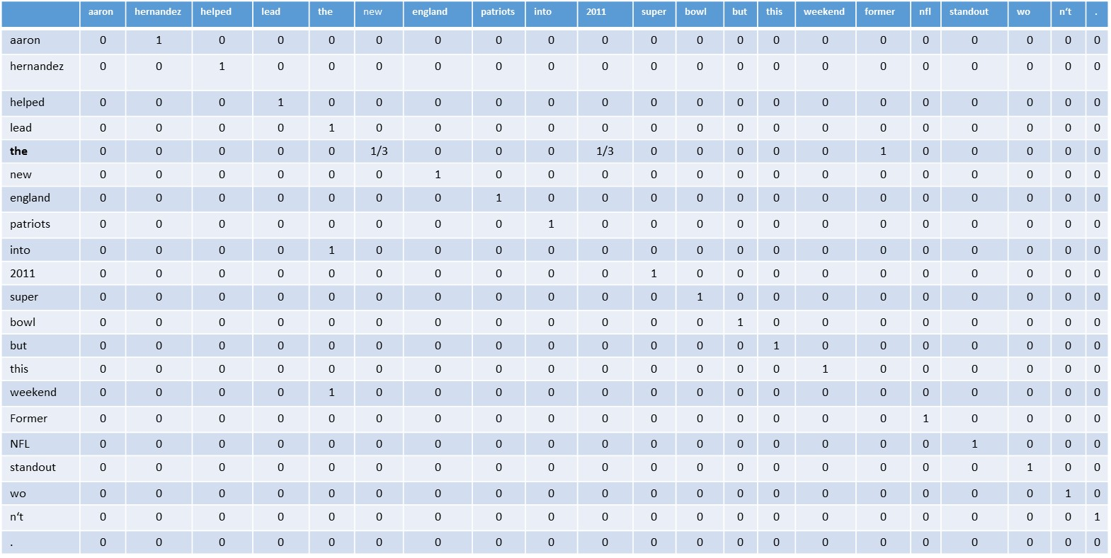
P(Aaron Hernandez helped lead the New England Patriots into the 2011 Super Bowl, but this weekend, the former NFL standout ) =
P(aaron) *
P(hernandez|aaron) *
P(helped | Hernandez) *
P(lead | helped) *
P(the | lead) *
P(new | the) *
P(england | new) *
….
P(n’t| wo)
Bigram Relative Frequency Table

Slide 17
P(Aaron Hernandez helped lead the New England Patriots into the 2011 Super Bowl, but this weekend, the former NFL standout ) =
P(aaron) *
P(hernandez|aaron) *
P(helped | Hernandez) *
P(lead | helped) *
P(the | lead) *
P(new | the) *
P(england | new) *
….
P(n’t| wo)
Bigram Relative Frequency Table

Slide 18
Unigram | Frequency
aaron | 1
hernandez | 1
helped | 1
lead | 1
the | 3
new | 1
england | 1
patriots | 1
into | 1
2011 | 1
super | 1
bowl | 1
but | 1
this | 1
weekend | 1
Former | 1
nfl | 1
standout | 1
Wo | 1
n‘t | 1
. | 1
Aaron Hernandez helped lead the New England Patriots into the 2011 Super Bowl but this weekend the former NFL standout won’t.
…..
My
Tokenization
N = 23

Slide 19
Unigram | Frequency
aaron | 1
hernandez | 1
helped | 1
lead | 1
the | 3
new | 1
england | 1
patriots | 1
into | 1
2011 | 1
super | 1
bowl | 1
but | 1
this | 1
weekend | 1
Former | 1
nfl | 1
standout | 1
won | 1
‘t | 1
. | 1
Unigram | P(unigram)
aaron | 1/23 = 0.04
hernandez | 1/23 = 0.04
helped | 1/23 = 0.04
lead | 1/23 = 0.04
the | 3/23 = 0.13
new | 1/23 = 0.04
england | 1/23 = 0.04
patriots | 1/23 = 0.04
into | 1/23 = 0.04
2011 | 1/23 = 0.04
super | 1/23 = 0.04
bowl | 1/23 = 0.04
but | 1/23 = 0.04
this | 1/23 = 0.04
weekend | 1/23 = 0.04
Former | 1/23 = 0.04
nfl | 1/23 = 0.04
standout | 1/23 = 0.04
won | 1/23 = 0.04
‘t | 1/23 = 0.04
. | 1/23 = 0.04
P(unigram) = Freq(unigram) / N
N = 23

Slide 20
P(Aaron Hernandez helped lead the New England Patriots into the 2011 Super Bowl, but this weekend, the former NFL standout ) =
P(aaron) *
P(Hernandez|aaron) *
P(helped | Hernandez) *
P(lead | helped) *
P(the | lead) *
P(new | the) *
P(england | new) *
….
P(standout| NFL)
Get this from our relative frequency tables

Slide 21
Does that make sense?
Now let’s look at a different example and introduce
<start>
<end>

Slide 22
 | i | want | to | eat | chinese | food | lunch | spend | <start> | <end>
i | 5 | 827 | 0 | 9 | 0 | 0 | 0 | 2 | 0 | 0
want | 2 | 0 | 608 | 1 | 6 | 6 | 5 | 1 | 0 | 0
to | 2 | 0 | 4 | 686 | 2 | 0 | 6 | 211 | 0 | 0
eat | 0 | 0 | 2 | 0 | 16 | 2 | 42 | 0 | 0 | 34
chinese | 1 | 0 | 0 | 0 | 0 | 82 | 1 | 0 | 0 | 23
food | 15 | 0 | 15 | 0 | 1 | 1 | 0 | 0 | 0 | 12
lunch | 2 | 0 | 0 | 0 | 0 | 0 | 0 | 0 | 0 | 9
spend | 1 | 0 | 1 | 0 | 0 | 0 | 0 | 0 | 1 | 17
<start> | 45 | 0 | 30 | 0 | 15 | 10 | 3 | 0 | 0 | 0
<end> | 0 | 0 | 0 | 0 | 3 | 23 | 6 | 34 | 0 | 0
Bigram table of raw frequency’s
i | want | to | eat | chinese | food | lunch | spend | <start> | <end>
2533 | 927 | 2417 | 746 | 158 | 1093 | 341 | 278 | 3000 | 3000
Unigram table of raw frequency’s

Slide 23


Relative Frequency
 | i | want | to | eat | chinese | food | lunch | spend | <start> | <end>
i | 5 | 827 | 0 | 9 | 0 | 0 | 0 | 2 | 0 | 0
want | 2 | 0 | 608 | 1 | 6 | 6 | 5 | 1 | 0 | 0
to | 2 | 0 | 4 | 686 | 2 | 0 | 6 | 211 | 0 | 0
eat | 0 | 0 | 2 | 0 | 16 | 2 | 42 | 0 | 0 | 34
chinese | 1 | 0 | 0 | 0 | 0 | 82 | 1 | 0 | 0 | 23
food | 15 | 0 | 15 | 0 | 1 | 1 | 0 | 0 | 0 | 12
lunch | 2 | 0 | 0 | 0 | 0 | 0 | 0 | 0 | 0 | 9
spend | 1 | 0 | 1 | 0 | 0 | 0 | 0 | 0 | 1 | 17
<start> | 45 | 0 | 30 | 0 | 15 | 10 | 3 | 0 | 0 | 0
<end> | 0 | 0 | 0 | 0 | 3 | 23 | 6 | 34 | 0 | 0
$$P\left(w2|w1\right)= \frac{frequency(w1 w2)}{\sum_{w}{frequency(w1 w)}}$$
$$P\left(w2|w1\right)= \frac{frequency(w1 w2)}{frequency(w1)}$$
i | want | to | eat | chinese | food | lunch | spend | <start> | <end>
2533 | 927 | 2417 | 746 | 158 | 1093 | 341 | 278 | 3000 | 3000

Slide 24
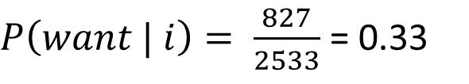
 | i | want | to | eat | chinese | food | lunch | spend | <start> | <end>
i | 5 | 827 | 0 | 9 | 0 | 0 | 0 | 2 | 0 | 0
want | 2 | 0 | 608 | 1 | 6 | 6 | 5 | 1 | 0 | 0
to | 2 | 0 | 4 | 686 | 2 | 0 | 6 | 211 | 0 | 0
eat | 0 | 0 | 2 | 0 | 16 | 2 | 42 | 0 | 0 | 34
chinese | 1 | 0 | 0 | 0 | 0 | 82 | 1 | 0 | 0 | 23
food | 15 | 0 | 15 | 0 | 1 | 1 | 0 | 0 | 0 | 12
lunch | 2 | 0 | 0 | 0 | 0 | 0 | 0 | 0 | 0 | 9
spend | 1 | 0 | 1 | 0 | 0 | 0 | 0 | 0 | 1 | 17
<start> | 45 | 0 | 30 | 0 | 15 | 10 | 3 | 0 | 0 | 0
<end> | 0 | 0 | 0 | 0 | 3 | 23 | 6 | 34 | 0 | 0
$$P\left(w2|w1\right)= \frac{frequency(w1 w2)}{\sum_{w}{frequency(w1 w)}}$$
$$P\left(w2|w1\right)= \frac{frequency(w1 w2)}{frequency(w1)}$$
I | want | to | eat | chinese | food | lunch | spend | <start> | <end>
2533 | 927 | 2417 | 746 | 158 | 1093 | 341 | 278 | 3000 | 3000
$P\left(want | i\right)= \frac{827}{2533}$ = 0.33

Slide 25
 | i | want | to | eat | chinese | food | lunch | spend | <start> | <end>
i | 0.002 | 0.33 | 0 | 0.0036 | 0 | 0 | 0 | 0.00079 | 0 | 0
want | 0.0022 | 0 | 0.66 | 0.0011 | 0.0065 | 0.0065 | 0.0064 | 0.0011 | 0 | 0
to | 0.00083 | 0 | 0.0017 | 0.28 | 0.00083 | 0 | 0.0025 | 0.087 | 0 | 0
eat | 0 | 0 | 0.0027 | 0 | 0.021 | 0.0027 | 0.056 | 0 | 0 | 0.011
chinese | 0.0063 | 0 | 0 | 0 | 0 | 0.52 | 0.0063 | 0 | 0 | 0.008
food | 0.014 | 0 | 0.014 | 0 | 0.00092 | 0.0037 | 0 | 0 | 0 | 0.004
lunch | 0.0059 | 0 | 0 | 0 | 0 | 0.0029 | 0 | 0 | 0 | 0.003
spend | 0.0036 | 0 | 0.0036 | 0 | 0 | 0 | 0 | 0 | 1 | 0.006
<start> | 0.015 | 0 | 0.01 | 0 | 0.005 | 0.003 | 0.001 | 0 | 0 | 0
<end> | 0 | 0 | 0 | 0 | 0.001 | 0.007 | 0.002 | 0.011 | 0 | 0
Relative Frequency Table

Slide 26


$$P\left(w2|w1\right)= \frac{frequency(w1 w2)}{\sum_{w}{frequency(w1 w)}}$$
$$P\left(w2|w1\right)= \frac{frequency(w1 w2)}{frequency(w1)}$$
For bigrams
$$How do we generalize this for all n−grams$$

Slide 27


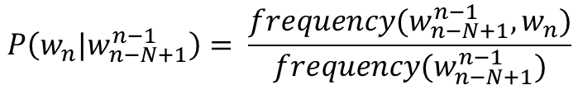
$$P\left(w2|w1\right)= \frac{frequency(w1 w2)}{\sum_{w}{frequency(w1 w)}}$$
$$P\left(w2|w1\right)= \frac{frequency(w1 w2)}{frequency(w1)}$$
For bigrams
Any n-gram
$$P\left(w_{n}|w_{n−N+1}^{n−1}\right)= \frac{frequency(w_{n−N+1}^{n−1},w_{n})}{{frequency(w}_{n−N+1}^{n−1})}$$

Slide 28
$$P\left(w2|w1\right)= \frac{frequency(w1 w2)}{\sum_{w}{frequency(w1 w)}}$$
$$P\left(w2|w1\right)= \frac{frequency(w1 w2)}{frequency(w1)}$$
For bigrams
Any n-gram
$$P\left(w_{n}|w_{n−N+1}^{n−1}\right)= \frac{frequency(w_{n−N+1}^{n−1},w_{n})}{{frequency(w}_{n−N+1}^{n−1})}$$

Slide 29


$$P\left(w2|w1\right)= \frac{frequency(w1 w2)}{\sum_{w}{frequency(w1 w)}}$$
$$P\left(w2|w1\right)= \frac{frequency(w1 w2)}{frequency(w1)}$$
For bigrams
Any n-gram
$$P\left(w_{n}|w_{n−N+1}^{n−1}\right)= \frac{frequency(w_{n−N+1}^{n−1},w_{n})}{{frequency(w}_{n−N+1}^{n−1})}$$
Trigram Model:
$$P\left(unicorns|the magical\right)= \frac{frequency(the magical unicorns)}{frequency(the magical)}$$

Slide 30
$$P\left(w2|w1\right)= \frac{frequency(w1 w2)}{\sum_{w}{frequency(w1 w)}}$$
$$P\left(w2|w1\right)= \frac{frequency(w1 w2)}{frequency(w1)}$$
For bigrams
Any n-gram
$$P\left(w_{n}|w_{n−N+1}^{n−1}\right)= \frac{frequency(w_{n−N+1}^{n−1},w_{n})}{{frequency(w}_{n−N+1}^{n−1})}$$
Trigram Model:
$$P\left(unicorns|the magical\right)= \frac{frequency(the magical unicorns)}{frequency(the magical)}$$
4-gram Model:
$$P\left(unicorns|the heroic magical\right)= \frac{frequency(the heroic magical unicorns)}{frequency(the heroic magical)}$$

Slide 31
$$P\left(w2|w1\right)= \frac{frequency(w1 w2)}{\sum_{w}{frequency(w1 w)}}$$
$$P\left(w2|w1\right)= \frac{frequency(w1 w2)}{frequency(w1)}$$
For bigrams
Any n-gram
$$P\left(w_{n}|w_{n−N+1}^{n−1}\right)= \frac{frequency(w_{n−N+1}^{n−1},w_{n})}{{frequency(w}_{n−N+1}^{n−1})}$$
Trigram Model:
$$P\left(unicorns|the magical\right)= \frac{frequency(the magical unicorns)}{frequency(the magical)}$$
4-gram Model:
$$P\left(unicorns|the heroic magical\right)= \frac{frequency(the heroic magical unicorns)}{frequency(the heroic magical)}$$
5-gram Model:
$$P\left(unicorns|the heroic unseen magical\right)= \frac{frequency(the heroic unseen magical unicorns)}{frequency(the heroic unseen magical)}$$

Slide 32
To calculate these we use: two tables
N-gram table
and
(N-1)-gram tables

Slide 33
Any questions?

Slide 34
How to Generate Sentences
We know to begin the sentences
we want to use the <start> tag
 | i | want | to | eat | chinese | food | lunch | spend | <start> | <end>
i | 0.002 | 0.33 | 0 | 0.0036 | 0 | 0 | 0 | 0.00079 | 0 | 0
want | 0.0022 | 0 | 0.66 | 0.0011 | 0.0065 | 0.0065 | 0.0064 | 0.0011 | 0 | 0
to | 0.00083 | 0 | 0.0017 | 0.28 | 0.00083 | 0 | 0.0025 | 0.087 | 0 | 0
eat | 0 | 0 | 0.0027 | 0 | 0.021 | 0.0027 | 0.056 | 0 | 0 | 0.011
chinese | 0.0063 | 0 | 0 | 0 | 0 | 0.52 | 0.0063 | 0 | 0 | 0.008
food | 0.014 | 0 | 0.014 | 0 | 0.00092 | 0.0037 | 0 | 0 | 0 | 0.004
lunch | 0.0059 | 0 | 0 | 0 | 0 | 0.0029 | 0 | 0 | 0 | 0.003
spend | 0.0036 | 0 | 0.0036 | 0 | 0 | 0 | 0 | 0 | 1 | 0.006
<start> | 0.015 | 0 | 0.01 | 0 | 0.005 | 0.003 | 0.001 | 0 | 0 | 0
<end> | 0 | 0 | 0 | 0 | 0.001 | 0.007 | 0.002 | 0.011 | 0 | 0

Slide 35
How to Generate Sentences
We know to begin the sentences
we want to use the <start> tag
 | i | want | to | eat | chinese | food | lunch | spend | <start> | <end>
<start> | 0.15 | 0 | 0.1 | 0 | 0.4 | 0.3 | 0.05 | 0 | 0 | 0

Slide 36
How to Generate Sentences
We know to begin the sentences
we want to use the <start> tag
Now we are only interested in those
Words that follow <start>
(the non zero elements)
Why?
Because we are using
our language model
(the relative frequency table)
To generate the words in our sentence
 | i | want | to | eat | chinese | food | lunch | spend | <start> | <end>
<start> | 0.15 | 0 | 0.1 | 0 | 0.4 | 0.3 | 0.05 | 0 | 0 | 0

Slide 37
Which of the five choices do we choose
If we pick the one with the highest
probability our sentences are not going to
change very much
So
randomly pick one based on its distribution
 | i | to | chinese | food | lunch
<start> | 0.15 | 0.1 | 0.4 | 0.3 | 0.05

Slide 38
Which of the five choices do we choose
Randomly pick one based on its distribution
 | i | to | chinese | food | lunch
<start> | 0.15 | 0.1 | 0.4 | 0.3 | 0.05

Slide 39
Which of the five choices do we choose
 | i | to | chinese | food | lunch
<start> | 0.15 | 0.1 | 0.4 | 0.3 | 0.05
+
+
+
+
=
0.15
0.1
0.4
0.3
0.05
1
0
0.15
0.25
0.65
0.95
1
i
to
chinese
food
lunch
We can plot these probabilities
a line from 0 to 1

Slide 40
Which of the five choices do we choose
 | i | to | chinese | food | lunch
<start> | 0.15 | 0.1 | 0.4 | 0.3 | 0.05
+
+
+
+
=
0.15
0.1
0.4
0.3
0.05
1
0
0.15
0.25
0.65
0.95
1
i
to
chinese
food
lunch
We can plot these probabilities
a line from 0 to 1
Now we can randomly pick what word
Follows <start> given the distribution
of them occurring within the text

Slide 41
Which of the five choices do we choose
Pick a random number between zero and one
my $r = rand();
And then see where it falls on the distribution:
if($r <= 0.44) { $next_word = “i”; }
elsif($r <= 0.73) { $next_word = “to”; }
elsif($r <= 0.88){ $next_word = “chinese”; }
elsif($r <= 0.97) { $next_word = “food”; }
else { $next_word = “lunch”; }
 | i | to | chinese | food | lunch
<start> | 0.15 | 0.1 | 0.4 | 0.3 | 0.05
+
+
+
+
=
0.15
0.1
0.4
0.3
0.05
1
0
0.15
0.25
0.65
0.95
1
i
to
chinese
food
lunch
We can plot these probabilities
a line from 0 to 1
Now we can randomly pick what word
Follows <start> given the distribution
of them occurring within the text

Slide 42
Which of the five choices do we choose
Pick a random number between zero and one
my $r = rand();
And then see where it falls on the distribution:
if($r <= 0.44) { $next_word = “i”; }
elsif($r <= 0.73) { $next_word = “to”; }
elsif($r <= 0.88){ $next_word = “chinese”; }
elsif($r <= 0.97) { $next_word = “food”; }
else { $next_word = “lunch”; }
 | i | to | chinese | food | lunch
<start> | 0.15 | 0.1 | 0.4 | 0.3 | 0.05
+
+
+
+
=
0.15
0.1
0.4
0.3
0.05
1
0
0.15
0.25
0.65
0.95
1
i
to
chinese
food
lunch
We can plot these probabilities
a line from 0 to 1
Now we can randomly pick what word
Follows <start> given the distribution
of them occurring within the text
So say our rand returned the value 0.6 what is our next word?

Slide 43
So then we start the process again with ‘to’
 | i | want | to | eat | chinese | food | lunch | spend | <start> | <end>
i | 0.002 | 0.33 | 0 | 0.0036 | 0 | 0 | 0 | 0.00079 | 0 | 0
want | 0.0022 | 0 | 0.66 | 0.0011 | 0.0065 | 0.0065 | 0.0064 | 0.0011 | 0 | 0
to | 0.00083 | 0 | 0.0017 | 0.28 | 0.00083 | 0 | 0.0025 | 0.087 | 0 | 0
eat | 0 | 0 | 0.0027 | 0 | 0.021 | 0.0027 | 0.056 | 0 | 0 | 0.011
chinese | 0.0063 | 0 | 0 | 0 | 0 | 0.52 | 0.0063 | 0 | 0 | 0.008
food | 0.014 | 0 | 0.014 | 0 | 0.00092 | 0.0037 | 0 | 0 | 0 | 0.004
lunch | 0.0059 | 0 | 0 | 0 | 0 | 0.0029 | 0 | 0 | 0 | 0.003
spend | 0.0036 | 0 | 0.0036 | 0 | 0 | 0 | 0 | 0 | 1 | 0.006
<start> | 0.015 | 0 | 0.01 | 0 | 0.005 | 0.003 | 0.001 | 0 | 0 | 0
<end> | 0 | 0 | 0 | 0 | 0.001 | 0.007 | 0.002 | 0.011 | 0 | 0

Slide 44
Do you see how this extends any n-gram?
 | am | eat | dish | … | box
<start> i | 0.44 | 0.29 | 0.15 | … | 0.03

Slide 45
And before we move on Perl’s Hashes of Hashes
my $n = shift;
my %hash = ();
while(<>) {
chomp;
my @array = split/\s+/;
for my $i(0..$#array) {
my $j = $i + $n - 1;
my $first = $array[$i];
my $ngram = "";
if($j > $#array) { next; }
for my $k ($i..$j) {
$ngram .= "$array[$k] ";
}
chomp $ngram;
$hash{$first}{$ngram}++;
}
}

Slide 46
Scarcity
As N increases the accuracy of our model increase
But
As N increases the sparsely of our model increases

Slide 47
 | i | want | to | eat | chinese | food | lunch | spend | <start> | <end>
i | 0.002 | 0.33 | 0 | 0.0036 | 0 | 0 | 0 | 0.00079 | 0 | 0
want | 0.0022 | 0 | 0.66 | 0.0011 | 0.0065 | 0.0065 | 0.0064 | 0.0011 | 0 | 0
to | 0.00083 | 0 | 0.0017 | 0.28 | 0.00083 | 0 | 0.0025 | 0.087 | 0 | 0
eat | 0 | 0 | 0.0027 | 0 | 0.021 | 0.0027 | 0.056 | 0 | 0 | 0.011
chinese | 0.0063 | 0 | 0 | 0 | 0 | 0.52 | 0.0063 | 0 | 0 | 0.008
food | 0.014 | 0 | 0.014 | 0 | 0.00092 | 0.0037 | 0 | 0 | 0 | 0.004
lunch | 0.0059 | 0 | 0 | 0 | 0 | 0.0029 | 0 | 0 | 0 | 0.003
spend | 0.0036 | 0 | 0.0036 | 0 | 0 | 0 | 0 | 0 | 1 | 0.006
<start> | 0.015 | 0 | 0.01 | 0 | 0.005 | 0.003 | 0.001 | 0 | 0 | 0
<end> | 0 | 0 | 0 | 0 | 0.001 | 0.007 | 0.002 | 0.011 | 0 | 0
LOOK AT ALL THE ZERO’S

Slide 48
 | i | want | to | eat | chinese | food | lunch | spend | <start> | <end>
i | 0.002 | 0.33 | 0 | 0.0036 | 0 | 0 | 0 | 0.00079 | 0 | 0
want | 0.0022 | 0 | 0.66 | 0.0011 | 0.0065 | 0.0065 | 0.0064 | 0.0011 | 0 | 0
to | 0.00083 | 0 | 0.0017 | 0.28 | 0.00083 | 0 | 0.0025 | 0.087 | 0 | 0
eat | 0 | 0 | 0.0027 | 0 | 0.021 | 0.0027 | 0.056 | 0 | 0 | 0.011
chinese | 0.0063 | 0 | 0 | 0 | 0 | 0.52 | 0.0063 | 0 | 0 | 0.008
food | 0.014 | 0 | 0.014 | 0 | 0.00092 | 0.0037 | 0 | 0 | 0 | 0.004
lunch | 0.0059 | 0 | 0 | 0 | 0 | 0.0029 | 0 | 0 | 0 | 0.003
spend | 0.0036 | 0 | 0.0036 | 0 | 0 | 0 | 0 | 0 | 1 | 0.006
<start> | 0.015 | 0 | 0.01 | 0 | 0.005 | 0.003 | 0.001 | 0 | 0 | 0
<end> | 0 | 0 | 0 | 0 | 0.001 | 0.007 | 0.002 | 0.011 | 0 | 0
Does this mean that P(want|spend) = 0?
With the model, yes but in real life?

Slide 49

 | i | want | to | eat | chinese | food | lunch | spend | <start> | <end>
i | 0.002 | 0.33 | 0 | 0.0036 | 0 | 0 | 0 | 0.00079 | 0 | 0
want | 0.0022 | 0 | 0.66 | 0.0011 | 0.0065 | 0.0065 | 0.0064 | 0.0011 | 0 | 0
to | 0.00083 | 0 | 0.0017 | 0.28 | 0.00083 | 0 | 0.0025 | 0.087 | 0 | 0
eat | 0 | 0 | 0.0027 | 0 | 0.021 | 0.0027 | 0.056 | 0 | 0 | 0.011
chinese | 0.0063 | 0 | 0 | 0 | 0 | 0.52 | 0.0063 | 0 | 0 | 0.008
food | 0.014 | 0 | 0.014 | 0 | 0.00092 | 0.0037 | 0 | 0 | 0 | 0.004
lunch | 0.0059 | 0 | 0 | 0 | 0 | 0.0029 | 0 | 0 | 0 | 0.003
spend | 0.0036 | 0 | 0.0036 | 0 | 0 | 0 | 0 | 0 | 1 | 0.006
<start> | 0.015 | 0 | 0.01 | 0 | 0.005 | 0.003 | 0.001 | 0 | 0 | 0
<end> | 0 | 0 | 0 | 0 | 0.001 | 0.007 | 0.002 | 0.011 | 0 | 0
$$P\left(I want to eat English Food\right)=$$

Slide 50
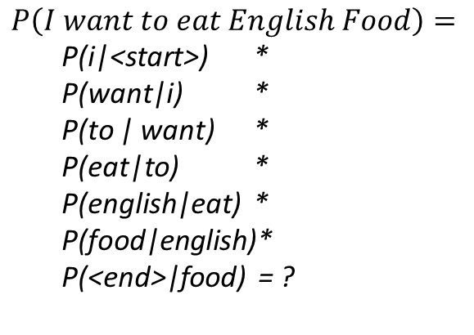
 | i | want | to | eat | chinese | food | lunch | spend | <start> | <end>
i | 0.002 | 0.33 | 0 | 0.0036 | 0 | 0 | 0 | 0.00079 | 0 | 0
want | 0.0022 | 0 | 0.66 | 0.0011 | 0.0065 | 0.0065 | 0.0064 | 0.0011 | 0 | 0
to | 0.00083 | 0 | 0.0017 | 0.28 | 0.00083 | 0 | 0.0025 | 0.087 | 0 | 0
eat | 0 | 0 | 0.0027 | 0 | 0.021 | 0.0027 | 0.056 | 0 | 0 | 0.011
chinese | 0.0063 | 0 | 0 | 0 | 0 | 0.52 | 0.0063 | 0 | 0 | 0.008
food | 0.014 | 0 | 0.014 | 0 | 0.00092 | 0.0037 | 0 | 0 | 0 | 0.004
lunch | 0.0059 | 0 | 0 | 0 | 0 | 0.0029 | 0 | 0 | 0 | 0.003
spend | 0.0036 | 0 | 0.0036 | 0 | 0 | 0 | 0 | 0 | 1 | 0.006
<start> | 0.015 | 0 | 0.01 | 0 | 0.005 | 0.003 | 0.001 | 0 | 0 | 0
<end> | 0 | 0 | 0 | 0 | 0.001 | 0.007 | 0.002 | 0.011 | 0 | 0
$$P\left(I want to eat English Food\right)=$$
P(i|<start>) *
P(want|i) *
P(to | want) *
P(eat|to) *
P(english|eat) *
P(food|english)*
P(<end>|food) = ?

Slide 51
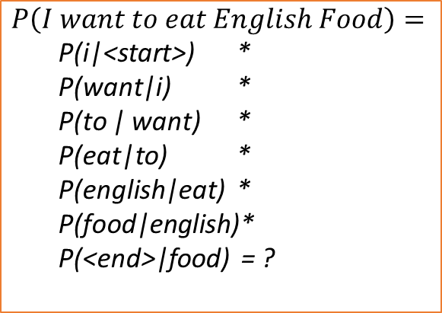
 | i | want | to | eat | chinese | food | lunch | spend | <start> | <end>
i | 0.002 | 0.33 | 0 | 0.0036 | 0 | 0 | 0 | 0.00079 | 0 | 0
want | 0.0022 | 0 | 0.66 | 0.0011 | 0.0065 | 0.0065 | 0.0064 | 0.0011 | 0 | 0
to | 0.00083 | 0 | 0.0017 | 0.28 | 0.00083 | 0 | 0.0025 | 0.087 | 0 | 0
eat | 0 | 0 | 0.0027 | 0 | 0.021 | 0.0027 | 0.056 | 0 | 0 | 0.011
chinese | 0.0063 | 0 | 0 | 0 | 0 | 0.52 | 0.0063 | 0 | 0 | 0.008
food | 0.014 | 0 | 0.014 | 0 | 0.00092 | 0.0037 | 0 | 0 | 0 | 0.004
lunch | 0.0059 | 0 | 0 | 0 | 0 | 0.0029 | 0 | 0 | 0 | 0.003
spend | 0.0036 | 0 | 0.0036 | 0 | 0 | 0 | 0 | 0 | 1 | 0.006
<start> | 0.015 | 0 | 0.01 | 0 | 0.005 | 0.003 | 0.001 | 0 | 0 | 0
<end> | 0 | 0 | 0 | 0 | 0.001 | 0.007 | 0.002 | 0.011 | 0 | 0
$$P\left(I want to eat English Food\right)=$$
P(i|<start>) *
P(want|i) *
P(to | want) *
P(eat|to) *
P(english|eat) *
P(food|english)*
P(<end>|food) = ?
P(i|<start>) = 0.015
P(want|i) = 0.33
P(to | want) = 0.66
P(eat|to) = 0.28
P(english|eat) = 0
P(food|english) = 0
P(<end>|food) = 0.007

Slide 52
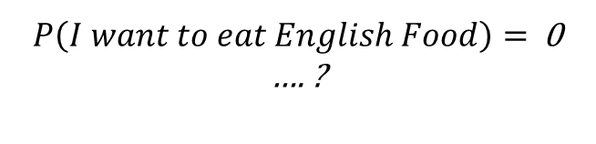
 | i | want | to | eat | chinese | food | lunch | spend | <start> | <end>
i | 0.002 | 0.33 | 0 | 0.0036 | 0 | 0 | 0 | 0.00079 | 0 | 0
want | 0.0022 | 0 | 0.66 | 0.0011 | 0.0065 | 0.0065 | 0.0064 | 0.0011 | 0 | 0
to | 0.00083 | 0 | 0.0017 | 0.28 | 0.00083 | 0 | 0.0025 | 0.087 | 0 | 0
eat | 0 | 0 | 0.0027 | 0 | 0.021 | 0.0027 | 0.056 | 0 | 0 | 0.011
chinese | 0.0063 | 0 | 0 | 0 | 0 | 0.52 | 0.0063 | 0 | 0 | 0.008
food | 0.014 | 0 | 0.014 | 0 | 0.00092 | 0.0037 | 0 | 0 | 0 | 0.004
lunch | 0.0059 | 0 | 0 | 0 | 0 | 0.0029 | 0 | 0 | 0 | 0.003
spend | 0.0036 | 0 | 0.0036 | 0 | 0 | 0 | 0 | 0 | 1 | 0.006
<start> | 0.015 | 0 | 0.01 | 0 | 0.005 | 0.003 | 0.001 | 0 | 0 | 0
<end> | 0 | 0 | 0 | 0 | 0.001 | 0.007 | 0.002 | 0.011 | 0 | 0
$$P\left(I want to eat English Food\right)=$$
P(i|<start>) *
P(want|i) *
P(to | want) *
P(eat|to) *
P(english|eat) *
P(food|english)*
P(<end>|food) = ?
P(i|<start>) = 0.015
P(want|i) = 0.33
P(to | want) = 0.66
P(eat|to) = 0.28
P(english|eat) = 0
P(food|english) = 0
P(<end>|food) = 0.007
Uh oh!
$P\left(I want to eat English Food\right)=$ 0 …. ?

Slide 53
Sparicity
Sparcity is a major problem for Maximum Likelihood Estimation

Slide 54
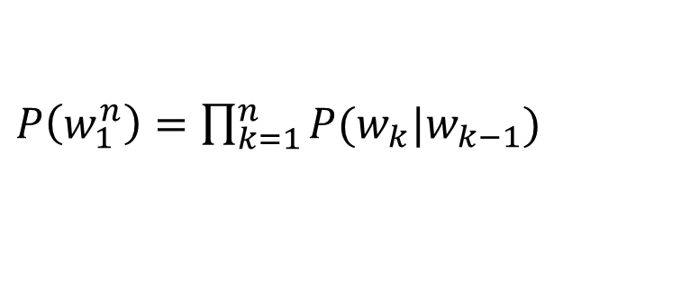
Recap MLE
Sparsity is a major problem for Maximum Likelihood Estimation
This is MLE =>
$P\left(w_{1}^{n}\right)=\prod_{k=1}^{n}{P(w_{k}|w_{k−1})}$

Slide 55
MLE with code
Sparsity is a major problem for Maximum Likelihood Estimation
my @w = {set of n words}
my $P_w = 1;
for my $k (1…n) {
$P_w *= $rel_freq_table{$w[$k]}{$w[$k-1]}
}
This is MLE =>
$P\left(w_{1}^{n}\right)=\prod_{k=1}^{n}{P(w_{k}|w_{k−1})}$

Slide 56
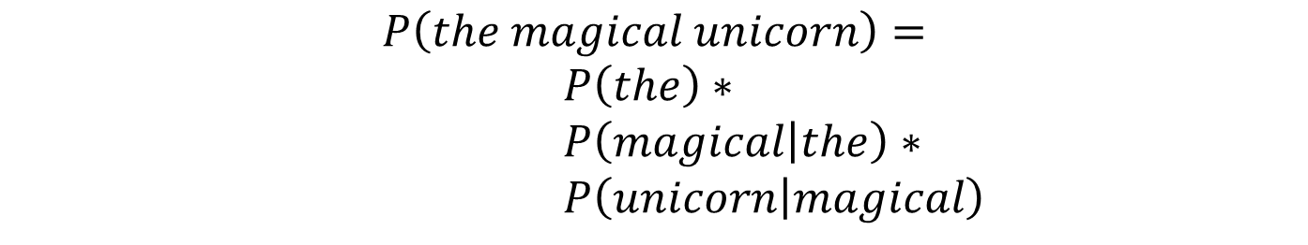
MLE with example
Sparsity is a major problem for Maximum Likelihood Estimation
This is MLE =>
$P\left(w_{1}^{n}\right)=\prod_{k=1}^{n}{P(w_{k}|w_{k−1})}$
$$P\left(the magical unicorn\right)=$$
$P\left(the\right)∗$
$P\left(magical | the\right)∗$
$P\left(unicorn | magical\right)$

Slide 57
MLE with example
Sparsity is a major problem for Maximum Likelihood Estimation
This is MLE =>
$P\left(w_{1}^{n}\right)=\prod_{k=1}^{n}{P(w_{k}|w_{k−1})}$
$$P\left(the magical unicorn\right)=$$
$P\left(the\right)∗$
$P\left(magical | the\right)∗$
$P\left(unicorn | magical\right)$
These probabilities are referred to as Relative Frequency

Slide 58

Relative Frequency
Sparsity is a major problem for Maximum Likelihood Estimation
This is MLE =>
$P\left(w_{1}^{n}\right)=\prod_{k=1}^{n}{P(w_{k}|w_{k−1})}$
This is Relative Frequency =>
$$P(w_{k}|w_{k−1})$$
$P\left(unicorn | magical\right)=\frac{Frequency(magical unicorn)}{Frequency(magical)}$
$rel_freq_table{$w[$k]}{$w[$k-1]}

Slide 59
Sparcity
 | i | want | to | eat | chinese | food | lunch | spend | <start> | <end>
i | 0.002 | 0.33 | 0 | 0.0036 | 0 | 0 | 0 | 0.00079 | 0 | 0
want | 0.0022 | 0 | 0.66 | 0.0011 | 0.0065 | 0.0065 | 0.0064 | 0.0011 | 0 | 0
to | 0.00083 | 0 | 0.0017 | 0.28 | 0.00083 | 0 | 0.0025 | 0.087 | 0 | 0
eat | 0 | 0 | 0.0027 | 0 | 0.021 | 0.0027 | 0.056 | 0 | 0 | 0.011
chinese | 0.0063 | 0 | 0 | 0 | 0 | 0.52 | 0.0063 | 0 | 0 | 0.008
food | 0.014 | 0 | 0.014 | 0 | 0.00092 | 0.0037 | 0 | 0 | 0 | 0.004
lunch | 0.0059 | 0 | 0 | 0 | 0 | 0.0029 | 0 | 0 | 0 | 0.003
spend | 0.0036 | 0 | 0.0036 | 0 | 0 | 0 | 0 | 0 | 1 | 0.006
<start> | 0.015 | 0 | 0.01 | 0 | 0.005 | 0.003 | 0.001 | 0 | 0 | 0
<end> | 0 | 0 | 0 | 0 | 0.001 | 0.007 | 0.002 | 0.011 | 0 | 0
Because we don’t see <start> eat in the text does this mean it doesn’t occur ever
Is P(<start> eat) really zero

Slide 60
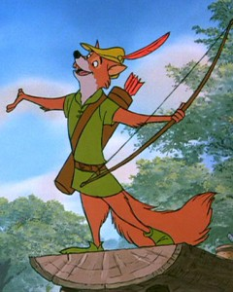
Smoothing
Exploit the Zipfian distribution of words
Two smoothing methods:
Laplace Smoothing
Good Turning
The basic idea is that we take a little from everything we see and give it to what we don’t see
Robin Hood: stealing from the rich and giving to the poor

Slide 61
Zipfian Distribution
Words follow a Zipfian Distribution
Small number of words occur very frequently
A large number of words are only seen once
Zipf’s Law: A word’s frequency is approximately inversely proportional to its rank in the word distribution list

Slide 62
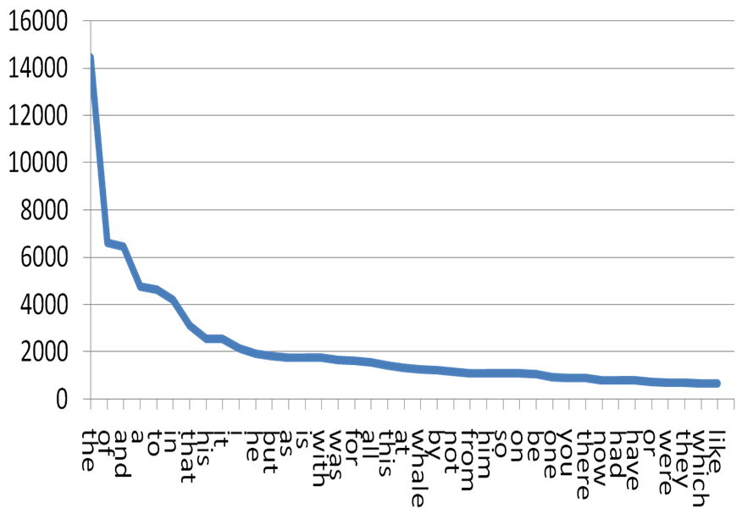

Slide 63
Great Video on Zipf
https://www.youtube.com/watch?v=fCn8zs912OE

Slide 64
Smoothing
Exploit the Zipfian distribution of words
Two smoothing methods:
Laplace Smoothing
Good Turning
The basic idea is that we take a little from everything we see and give it to what we don’t see
Robin Hood: stealing from the rich and giving to the poor

Slide 65

Laplace Smoothing
Simple metric : adds one to each count
$$P\left(w_{i}\right)= \frac{frequency(w_{i})}{N}$$
$$P_{Laplace}\left(w_{i}\right)= \frac{frequency\left(w_{i}\right)+1}{N+V}$$
N = the number of tokens in our corpus
V = the number of types in our corpus

Slide 66
Laplace Smoothing
Simple metric : adds one to each count
$$P\left(w_{i}\right)= \frac{frequency(w_{i})}{N}$$
$$P_{Laplace}\left(w_{i}\right)= \frac{frequency\left(w_{i}\right)+1}{N+V}$$
Adding V because you’ve added one to
each w seen in your corpus
N = the number of tokens in our corpus
V = the number of types in our corpus

Slide 67


The book refers to “adjusted count”
$${frequency}^{∗}\left(w_{i}\right)=\left(frequency\left(w_{i}\right)+1\right)\frac{N}{N+V}$$
$$P\left(w_{i}\right)=\frac{{frequency}^{∗}(w_{i})}{N}$$

Slide 68


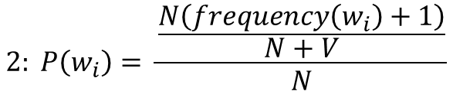
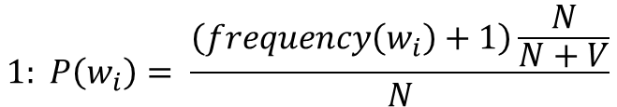
Adjusted count
$${frequency}^{∗}\left(w_{i}\right)=\left(frequency\left(w_{i}\right)+1\right)\frac{N}{N+V}$$
$$P\left(w_{i}\right)=\frac{{frequency}^{∗}(w_{i})}{N}$$
$$1: P\left(w_{i}\right)= \frac{\left(frequency\left(w_{i}\right)+1\right)\frac{N}{N+V}}{N}$$
$3: P\left(w_{i}\right)=\frac{N\left(frequency\left(w_{i}\right)+1\right)}{N+V} ∗ \frac{1}{N}$
$$2: P\left(w_{i}\right)= \frac{\frac{N\left(frequency\left(w_{i}\right)+1\right)}{N+V}}{N}$$
$$4: P\left(w_{i}\right)=\frac{\left(frequency\left(w_{i}\right)+1\right)}{N+V}$$

Slide 69
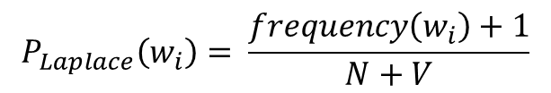
Adjusted count
$${frequency}^{∗}\left(w_{i}\right)=\left(frequency\left(w_{i}\right)+1\right)\frac{N}{N+V}$$
$$P\left(w_{i}\right)=\frac{{frequency}^{∗}(w_{i})}{N}$$
$$P_{Laplace}\left(w_{i}\right)= \frac{frequency\left(w_{i}\right)+1}{N+V}$$
$$1: P\left(w_{i}\right)= \frac{\left(frequency\left(w_{i}\right)+1\right)\frac{N}{N+V}}{N}$$
$3: P\left(w_{i}\right)=\frac{N\left(frequency\left(w_{i}\right)+1\right)}{N+V} ∗ \frac{1}{N}$
$$2: P\left(w_{i}\right)= \frac{\frac{N\left(frequency\left(w_{i}\right)+1\right)}{N+V}}{N}$$
$$4: P\left(w_{i}\right)=\frac{\left(frequency\left(w_{i}\right)+1\right)}{N+V}$$

Slide 70

Laplace Smoothing on Conditional Probabilities
$${P(w_{i})= \frac{frequency\left(w_{i}\right)}{N} ⇒ P}_{Laplace}\left(w_{i}\right)= \frac{frequency\left(w_{i}\right)+1}{N+V}$$
$P\left(w1|w2\right)= \frac{frequency(w1 w2)}{frequency(w1)}⇒P_{Laplace}\left(w_{i}\right)= ?$
V = the number of types in our corpus

Slide 71


Laplace Smoothing on Conditional Probabilities
$$P_{Laplace}\left(w_{n} | w_{n−1}\right)= \frac{frequency\left(w_{n−1}w_{n}\right)+1}{frequency\left(w_{n−1}\right)+V}$$
$${P(w_{i})= \frac{frequency\left(w_{i}\right)}{N} ⇒ P}_{Laplace}\left(w_{i}\right)= \frac{frequency\left(w_{i}\right)+1}{N+V}$$
$P\left(w1|w2\right)= \frac{frequency(w1, w2)}{frequency(w1)}⇒P_{Laplace}\left(w_{i}\right)= ?$
V = the number of types in our corpus

Slide 72
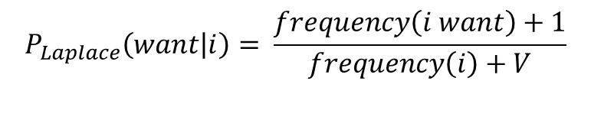
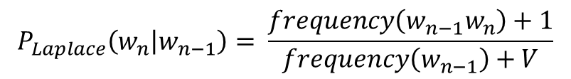
 | i | want | to | eat | chinese | food | lunch | spend | <start> | <end>
i | 5 | 827 | 0 | 9 | 0 | 0 | 0 | 2 | 0 | 0
want | 2 | 0 | 608 | 1 | 6 | 6 | 5 | 1 | 0 | 0
to | 2 | 0 | 4 | 686 | 2 | 0 | 6 | 211 | 0 | 0
eat | 0 | 0 | 2 | 0 | 16 | 2 | 42 | 0 | 0 | 34
chinese | 1 | 0 | 0 | 0 | 0 | 82 | 1 | 0 | 0 | 23
food | 15 | 0 | 15 | 0 | 1 | 1 | 0 | 0 | 0 | 12
lunch | 2 | 0 | 0 | 0 | 0 | 0 | 0 | 0 | 0 | 9
spend | 1 | 0 | 1 | 0 | 0 | 0 | 0 | 0 | 1 | 17
<start> | 45 | 0 | 30 | 0 | 15 | 10 | 3 | 0 | 0 | 0
<end> | 0 | 0 | 0 | 0 | 3 | 23 | 6 | 34 | 0 | 0
$$P_{Laplace}\left(w_{n} | w_{n−1}\right)= \frac{frequency\left(w_{n−1}w_{n}\right)+1}{frequency\left(w_{n−1}\right)+V}$$
$$P_{Laplace}\left(want | i\right)= \frac{frequency\left(i want\right)+1}{frequency\left(i\right)+V}$$
i | want | to | eat | chinese | food | lunch | spend | <start> | <end>
2533 | 927 | 2417 | 746 | 158 | 1093 | 341 | 278 | 3000 | 3000
V = 1446

Slide 73
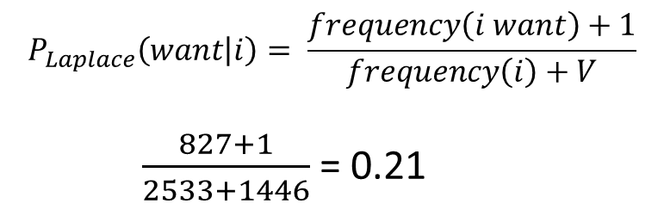
 | i | want | to | eat | chinese | food | lunch | spend | <start> | <end>
i | 5 | 827 | 0 | 9 | 0 | 0 | 0 | 2 | 0 | 0
want | 2 | 0 | 608 | 1 | 6 | 6 | 5 | 1 | 0 | 0
to | 2 | 0 | 4 | 686 | 2 | 0 | 6 | 211 | 0 | 0
eat | 0 | 0 | 2 | 0 | 16 | 2 | 42 | 0 | 0 | 34
chinese | 1 | 0 | 0 | 0 | 0 | 82 | 1 | 0 | 0 | 23
food | 15 | 0 | 15 | 0 | 1 | 1 | 0 | 0 | 0 | 12
lunch | 2 | 0 | 0 | 0 | 0 | 0 | 0 | 0 | 0 | 9
spend | 1 | 0 | 1 | 0 | 0 | 0 | 0 | 0 | 1 | 17
<start> | 45 | 0 | 30 | 0 | 15 | 10 | 3 | 0 | 0 | 0
<end> | 0 | 0 | 0 | 0 | 3 | 23 | 6 | 34 | 0 | 0
$$P_{Laplace}\left(w_{n} | w_{n−1}\right)= \frac{frequency\left(w_{n−1}w_{n}\right)+1}{frequency\left(w_{n−1}\right)+V}$$
$$P_{Laplace}\left(want | i\right)= \frac{frequency\left(i want\right)+1}{frequency\left(i\right)+V}$$
$\frac{827+1}{2533+1446}$ = 0.21
i | want | to | eat | chinese | food | lunch | spend | <start> | <end>
2533 | 927 | 2417 | 746 | 158 | 1093 | 341 | 278 | 3000 | 3000
V = 1446

Slide 74
 | i | want | to | eat | chinese | food | lunch | spend
i | 0.0015 | 0.21 | 0.00025 | 0.0025 | 0.00025 | 0.00025 | 0.00025 | 0.00075
want | 0.0013 | 0.00042 | 0.26 | 0.00084 | 0.0029 | 0.0029 | 0.0025 | 0.00084
to | 0.00078 | 0.00026 | 0.0013 | 0.18 | 0.00078 | 0.00026 | 0.0018 | 0.055
eat | 0.00046 | 0.00046 | 0.0014 | 0.00046 | 0.0078 | 0.0014 | 0.02 | 0.00046
chinese | 0.0012 | 0.00062 | 0.00062 | 0.00062 | 0.00062 | 0.052 | 0.0012 | 0.00062
food | 0.0063 | 0.00039 | 0.0063 | 0.00039 | 0.00079 | 0.002 | 0.00039 | 0.00039
lunch | 0.0017 | 0.00056 | 0.00056 | 0.00056 | 0.00056 | 0.00056 | 0.00056 | 0.00056
spend | 0.0012 | 0.00058 | 0.0012 | 0.00058 | 0.00058 | 0.00058 | 0.00058 | 0.00058
$$P_{Laplace}\left(w_{n} | w_{n−1}\right)= \frac{frequency\left(w_{n−1}w_{n}\right)+1}{frequency\left(w_{n−1}\right)+V}$$
$$P_{Laplace}\left(want | i\right)= \frac{frequency\left(i want\right)+1}{frequency\left(i\right)+V}$$
$\frac{827+1}{2533+1446}$ = 0.21
V = 1446

Slide 75
Good Turing
Add-1 smoothing (Laplace smoothing) is a bit brute force
Few more elegant ways to smooth
Good Turning
Witten-Bell
Kneser-Ney

Slide 76
Good Turing
Intuition
Use the count of things you have seen once to help estimate the count of things you’ve never seen

Slide 77
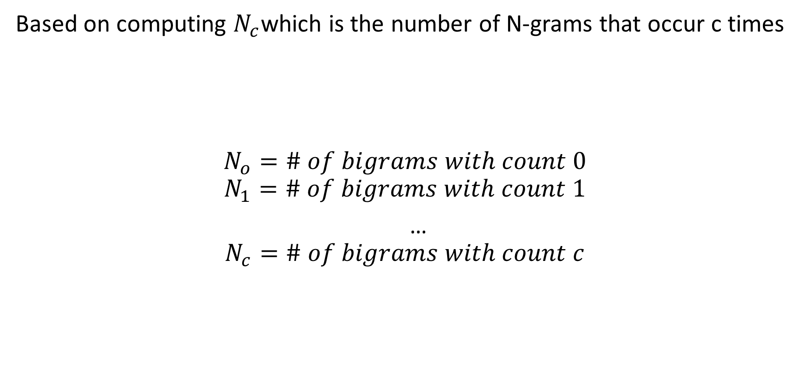
Good Turing
Based on computing $N_{c}$which is the number of N-grams that occur c times
$$N_{o}=\# of bigrams with count 0$$
$$N_{1}=\# of bigrams with count 1$$
…
$$N_{c}=\# of bigrams with count c$$
frequency of frequency

Slide 78

Redefine frequency
$${frequency}^{∗}\left(w_{i}\right)=\left(frequency\left(w_{i}\right)+1\right)\frac{N}{N+V}$$
Laplace Smoothing

Slide 79

Redefine frequency
$${frequency}^{∗}\left(w_{i}\right)=\left(frequency\left(w_{i}\right)+1\right)\frac{N}{N+V}$$
Laplace Smoothing
$${frequency}^{∗}\left(w_{i}\right)=\left(frequency\left(w_{i}\right)+1\right)\frac{N_{c+1}}{N_{c}}$$
Good Turing Smoothing

Slide 80
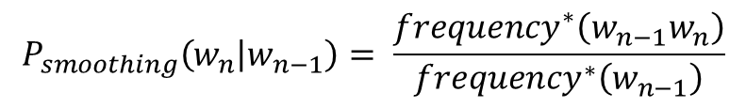
Redefine frequency
$${frequency}^{∗}\left(w_{i}\right)=\left(frequency\left(w_{i}\right)+1\right)\frac{N}{N+V}$$
Laplace Smoothing
$${frequency}^{∗}\left(w_{i}\right)=\left(frequency\left(w_{i}\right)+1\right)\frac{N_{c+1}}{N_{c}}$$
Good Turing Smoothing
$$P_{smoothing}\left(w_{n} | w_{n−1}\right)= \frac{{frequency}^{∗}\left(w_{n−1}w_{n}\right)}{{frequency}^{∗}\left(w_{n−1}\right)}$$

Slide 81
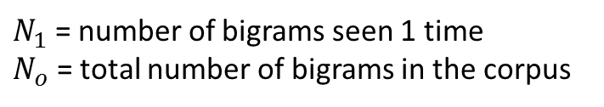

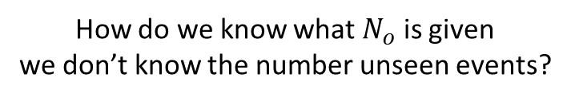
But what about unseen bigrams
$$P_{gt}\left(unseen\right)= \frac{N_{1}}{N_{o}}$$
$N_{1}$ = number of bigrams seen 1 time
$N_{o}$ = total number of bigrams in the corpus
How do we know what $N_{o}$ is given
we don’t know the number unseen events?

Slide 82
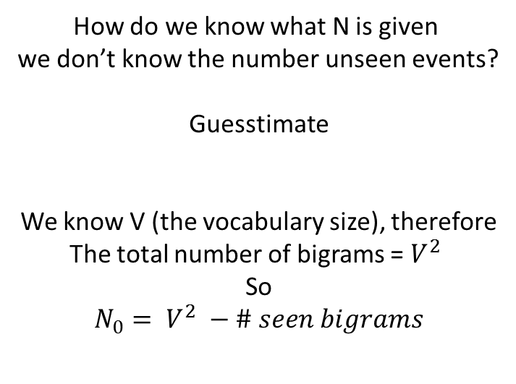
But what about unseen bigrams
$$P_{gt}\left(unseen\right)= \frac{N_{1}}{N_{o}}$$
$N_{1}$ = number of bigrams seen 1 time
$N_{o}$ = total number of bigrams in the corpus
How do we know what N is given
we don’t know the number unseen events?
Guesstimate
We know V (the vocabulary size), therefore
The total number of bigrams = $V^{2}$
So
$$N_{0}= V^{2} −\# seen bigrams$$

Slide 83


Frequency | Frequency(Frequency)
0 | 2081496
1 | 5315
2 | 1419
3 | 642
4 | 381
5 | 311
6 | 196
… | …
M | …
 | i | want | to | eat | chinese | food | lunch | spend | <start> | <end>
i | 5 | 827 | 0 | 9 | 0 | 0 | 0 | 2 | 0 | 0
i spend occurs twice in our corpus
$${frequency}^{∗}\left(w_{i}\right)=\left(frequency\left(w_{i}\right)+1\right)\frac{N_{c+1}}{N_{c}}$$
$${frequency}^{∗}\left(i spend\right)=\left(frequency\left(i spend\right)+1\right)\frac{N_{3}}{N_{2}}$$
${frequency}^{∗}\left(i spend\right)=\left(2+ 1\right)\frac{642}{1419}=$1.36
N = 2,081,496
$P_{gt}\left(spend | i\right)= \frac{{frequency}^{∗}(i spend)}{{frequency}^{∗}(i)}= \frac{1.36}{2534}=0.00054 (versus 0.00039)$

Slide 84
Frequency | Frequency(Frequency)
0 | 2081496
1 | 5315
2 | 1419
3 | 642
4 | 381
5 | 311
6 | 196
… | …
M | …
 | i | want | to | eat | chinese | food | lunch | spend | <start> | <end>
i | 5 | 827 | 0 | 9 | 0 | 0 | 0 | 2 | 0 | 0
i spend occurs twice in our corpus
$${frequency}^{∗}\left(w_{i}\right)=\left(frequency\left(w_{i}\right)+1\right)\frac{N_{c+1}}{N_{c}}$$
$${frequency}^{∗}\left(i spend\right)=\left(frequency\left(i spend\right)+1\right)\frac{N_{3}}{N_{2}}$$
${frequency}^{∗}\left(i spend\right)=\left(2+ 1\right)\frac{642}{1419}=$1.36
N = 2,081,496
$P_{gt}\left(spend | i\right)= \frac{{frequency}^{∗}(i spend)}{{frequency}^{∗}(i)}= \frac{1.36}{2534}=0.00054 (versus 0.00039)$
How do we know this?

Slide 85

Frequency | Frequency(Frequency)
0 | 2081496
1 | 5315
2 | 1419
3 | 642
4 | 381
5 | 311
6 | 196
… | …
M | …
 | i | want | to | eat | chinese | food | lunch | spend | <start> | <end>
i | 5 | 827 | 0 | 9 | 0 | 0 | 0 | 2 | 0 | 0
i spend occurs twice in our corpus
$${frequency}^{∗}\left(w_{i}\right)=\left(frequency\left(w_{i}\right)+1\right)\frac{N_{c+1}}{N_{c}}$$
$${frequency}^{∗}\left(i spend\right)=\left(frequency\left(i spend\right)+1\right)\frac{N_{3}}{N_{2}}$$
${frequency}^{∗}\left(i spend\right)=\left(2+ 1\right)\frac{642}{1419}=$1.36
N = 2,081,496
Frequency | Frequency(Frequency)
… | …
2533 | 2
2534 | 2
… | …
$P_{gt}\left(spend | i\right)= \frac{{frequency}^{∗}(i spend)}{{frequency}^{∗}(i)}= \frac{1.36}{2534}=0.00054 (versus 0.00039)$
$${frequency}^{∗}\left(w_{i}\right)=\left(frequency\left(w_{i}\right)+1\right)\frac{N_{c+1}}{N_{c}}$$
i | want | to | eat | chinese | food | lunch | spend | <start> | <end>
2533 | 927 | 2417 | 746 | 158 | 1093 | 341 | 278 | 3000 | 3000

Slide 86

Frequency | Frequency(Frequency)
0 | 2081496
1 | 5315
2 | 1419
3 | 642
4 | 381
5 | 311
6 | 196
… | …
M | …
 | i | want | to | eat | chinese | food | lunch | spend | <start> | <end>
i | 5 | 827 | 0 | 9 | 0 | 0 | 0 | 2 | 0 | 0
i spend occurs twice in our corpus
$${frequency}^{∗}\left(w_{i}\right)=\left(frequency\left(w_{i}\right)+1\right)\frac{N_{c+1}}{N_{c}}$$
$${frequency}^{∗}\left(i spend\right)=\left(frequency\left(i spend\right)+1\right)\frac{N_{3}}{N_{2}}$$
${frequency}^{∗}\left(i spend\right)=\left(2+ 1\right)\frac{642}{1419}=$1.36
N = 2,081,496
Frequency | Frequency(Frequency)
… | …
2533 | 2
2534 | 2
… | …
$P_{gt}\left(spend | i\right)= \frac{{frequency}^{∗}(i spend)}{{frequency}^{∗}(i)}= \frac{1.36}{2534}=0.00054 (versus 0.00039)$
$${frequency}^{∗}\left(w_{i}\right)=\left(frequency\left(w_{i}\right)+1\right)\frac{N_{c+1}}{N_{c}}$$
$${frequency}^{∗}\left(i\right)=\left(2533+ 1\right)\frac{2}{2}=2534$$
i | want | to | eat | chinese | food | lunch | spend | <start> | <end>
2533 | 927 | 2417 | 746 | 158 | 1093 | 341 | 278 | 3000 | 3000

Slide 87

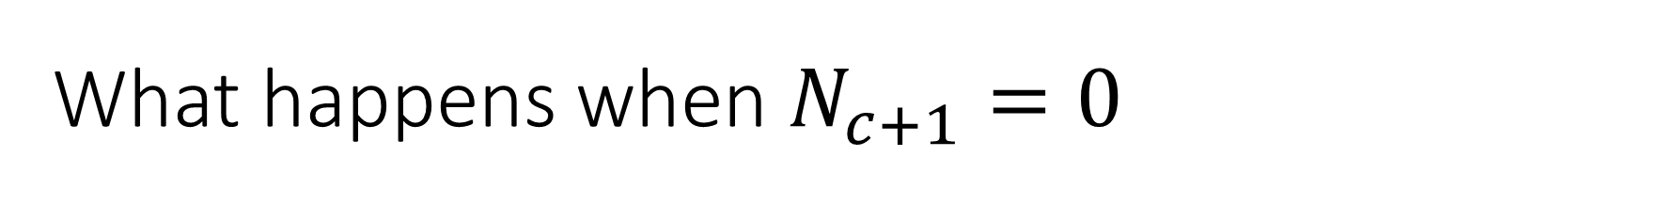
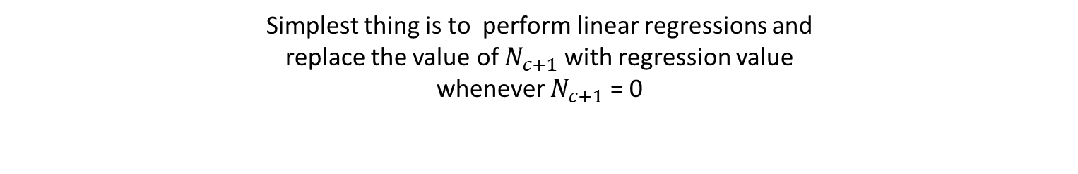
What happens when $N_{c+1}=0$
$${frequency}^{∗}\left(w_{i}\right)=\left(frequency\left(w_{i}\right)+1\right)\frac{N_{c+1}}{N_{c}}$$
Simplest thing is to perform linear regressions and
replace the value of $N_{c+1}$ with regression value
whenever $N_{c+1}$ = 0

Slide 88
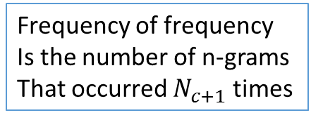
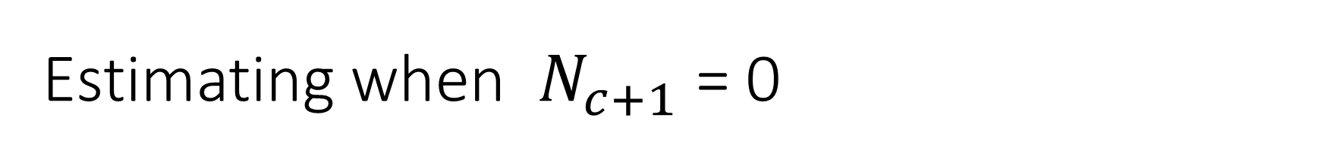

Estimating when $N_{c+1}$ = 0
Frequency of frequency
Is the number of n-grams
That occurred $N_{c+1}$ times
frequency
of
frequency
Step 1: Plot all the $N_{c}$ > 0
$$N_{0}$$

Slide 89

Estimating when $N_{c+1}$ = 0
Frequency of frequency
Is the number of n-grams
That occurred $N_{c+1}$ times
frequency
of
frequency
$$N_{0}$$
$$N_{1}$$

Slide 90




Estimating when $N_{c+1}$ = 0
Frequency of frequency
Is the number of n-grams
That occurred $N_{c+1}$ times
frequency
of
frequency
$$N_{0}$$
$$N_{1}$$
$$N_{2}$$
$$N_{3}$$
…
$$N_{c}$$
$$N_{c+2}$$

Slide 91
Estimating when $N_{c+1}$ = 0
Frequency of frequency
Is the number of n-grams
That occurred $N_{c+1}$ times
Step 2: Draw a regression line connecting the non-zero points
Please excuse my regression line – the computer does this better
frequency
of
frequency
$$N_{0}$$
$$N_{1}$$
$$N_{2}$$
$$N_{3}$$
…
$$N_{c}$$
$$N_{c+2}$$

Slide 92

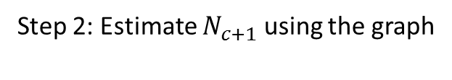
Estimating when $N_{c+1}$ = 0
Frequency of frequency
Is the number of n-grams
That occurred $N_{c+1}$ times
Step 2: Estimate $N_{c+1}$ using the graph
frequency
of
frequency
$$N_{0}$$
$$N_{1}$$
$$N_{2}$$
$$N_{3}$$
…
$$N_{c}$$
$$N_{c+2}$$
$$N_{c+1}$$

Slide 93
Questions?

